Slide 1

LLM: Unlocking Language Potential
Maximizing Efficiency through Advanced Techniques

Slide 2
Journey Overview
1. Foundations of Tokenization
Understanding Tokenization in LLMs : Explore the essence of tokenization and its pivotal role in language models.
Key Techniques: Word-Level vs. Subword-Level : Dive into when to use effective tokenization methods.
🔗 Transition to Subword-Level Tokenization: A Solution Unveiled
2. Advanced Tokenization Techniques
Byte Pair Encoding (BPE): Uncover the subword secrets that make LLMs like GPT and Llama so powerful.
WordPiece Algorithm: Examine how BERT harnesses subword units to improve handling of rare words.
3. Advanced Prompting Techniques
Traditional Prompting Strategies : COT, MCOT, Tree Prompting
Graph of Thoughts (GoT): Discover a revolutionary framework that transforms how LLMs reason by visualizing thought processes.
4.Parameter-Efficient Techniques
PEFT - LoRA & QLoRA: Learn how these innovative strategies optimize large models with minimal cost and maximum efficiency.
5. LLM Distillation
LLM Distillation: Understand the process of compressing knowledge from large models into smaller, effective ones.
Comparison: Traditional Fine-Tuning vs. Modern Approaches : Gain clarity on when to utilize each method for maximum impact.
Prompt & Prefix Tuning: Train specific embeddings while keeping pre-trained models intact. Discover real-world applications for legal and medical fields.

Slide 3
Impact of Tokenization in LLMs
Why can't LLM spell words? Tokenization.
Why can't LLM do super simple string processing tasks like reversing a string? Tokenization.
Why is LLM worse at non-English languages (e.g. Japanese)? Tokenization.
Why is LLM bad at simple arithmetic? Tokenization.
Why did GPT-2 have more than necessary trouble coding in Python? Tokenization.
Why did my LLM abruptly halt when it sees the string "<lendoftextl>"? Tokenization.
What is this weird warning I get about a "trailing whitespace"? Tokenization.
Why the LLM break if I ask it about "SolidGoldMagikarp"? Tokenization.
Why should I prefer to use YAML over JSON with LLMs? Tokenization.
Why is LLM not actually end-to-end language modeling? Tokenization.
What is the real root Of suffering? Tokenization.

Slide 4
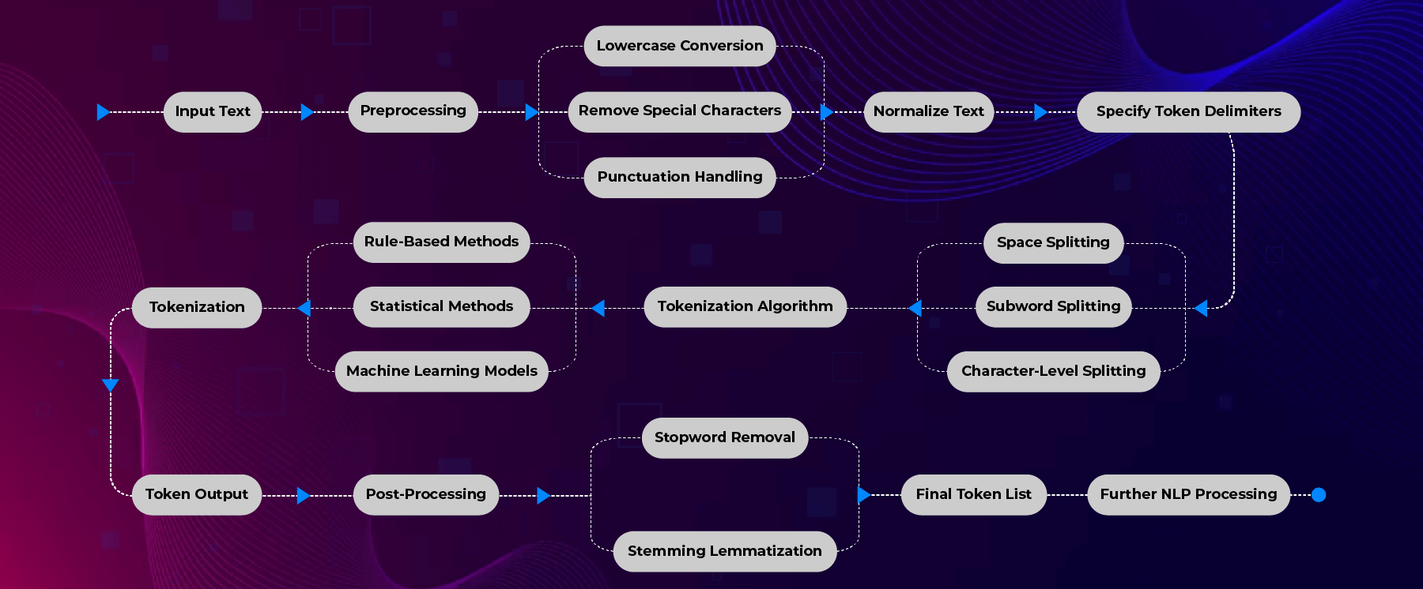
Understanding Tokenization

Slide 5
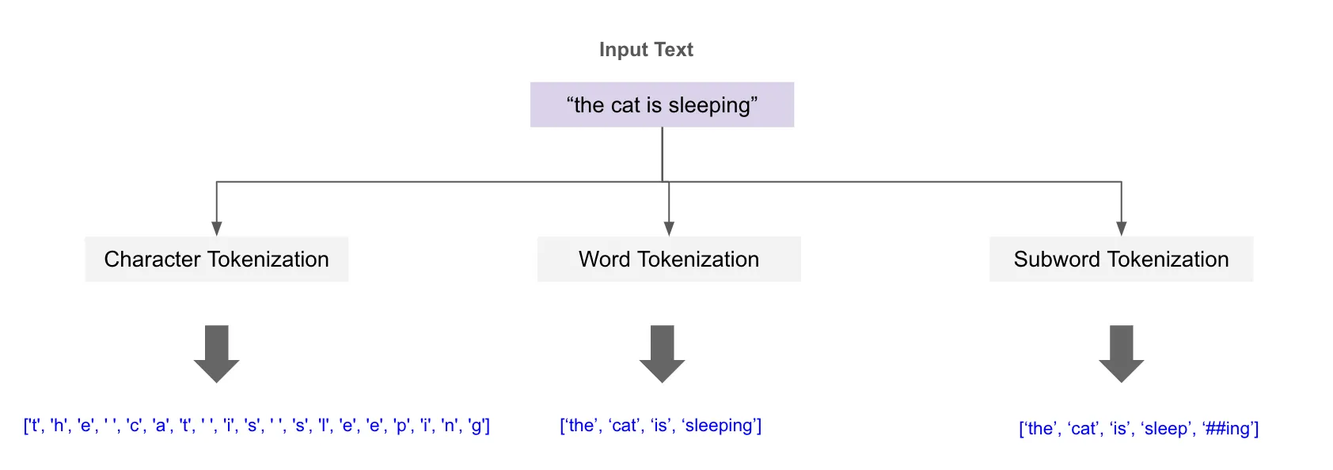
Exploring Key Tokenization Techniques and when to use it ?
Word-Level Tokenization
Pros
Effective for simple text in languages with stable word forms (e.g., English) and minimal inflections, enabling faster preprocessing and reduced memory usage.
Cons
Struggles with rare or out-of-vocabulary words (e.g., "tokenization" may be unrecognized). And Ineffective for morphologically rich languages, where words can have multiple forms based on tense, number, etc.
Memory inefficient due to large vocabulary size, as each unique word is treated as a separate token.
Transition to Subword-Level Tokenization
In contexts where word-level approaches fall short, subword-level tokenization offers a solution by breaking words into meaningful segments.
This method is especially beneficial for addressing the limitations of word-level tokenization, particularly with rare or out-of-vocabulary words and complex linguistic structures.
Common techniques include Byte Pair Encoding (BPE) and WordPiece, which we will explore next to understand their mechanisms and advantages in more detail.

Slide 6
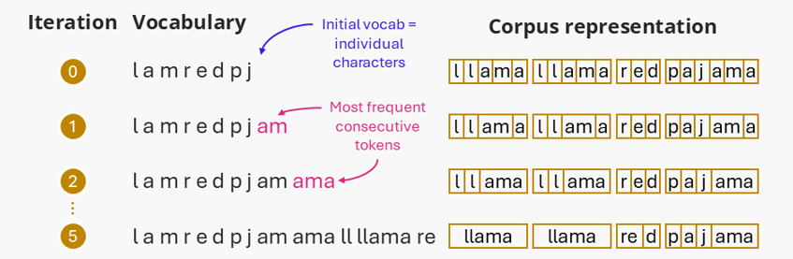
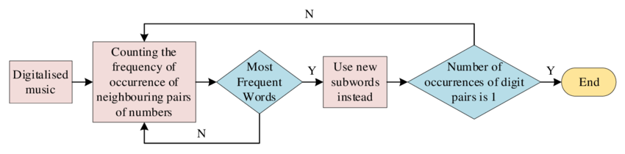
Byte Pair Encoding (BPE)
Byte-pair Encoding (BPE) is a tokenization algorithm which is used by most LLMs (e.g., GPT, Llama) to build their vocabularies.
Tokens created by BPE are called subwords because they are often smaller than words - these are typically the most common subwords that appear in the pretraining set.
Notes:
Here’s how it works, step by step:
Start with characters as the initial vocabulary: Treat each character in the text as a separate token.
Identify the most frequent pairs of tokens: Scan the corpus to find the pair of tokens (characters or subwords) that appears together most frequently.
Merge the most frequent pair: Replace all occurrences of this pair with a single new token, effectively creating a subword unit.
Repeat: Continue merging the most frequent pairs until reaching a specified vocabulary size or until the pairs no longer occur frequently enough to justify merging.

Slide 7
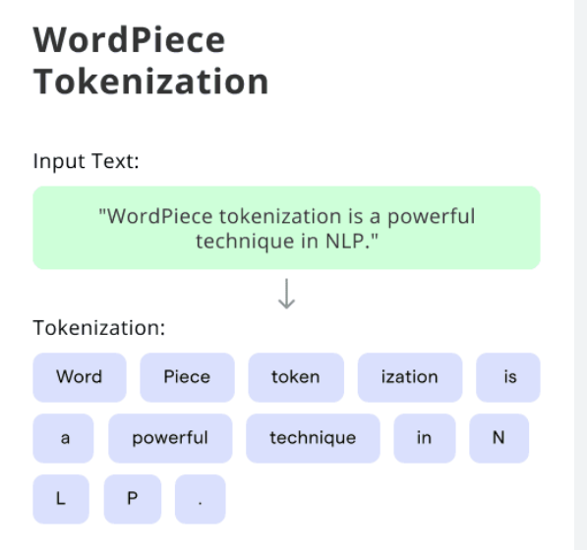
Word Piece Tokenization Algorithm
WordPiece Tokenization is a subword-based algorithm that breaks words into smaller meaningful units (subwords), improving handling of rare words and out-of-vocabulary (OOV) words.
Used in BERT, DistilBERT, and other Transformer models.
How It Works
Start with individual characters as tokens.
Iteratively merge most frequent token pairs into new subwords.
Stops when predefined vocabulary size is reached.
Uncommon words get broken into subwords.
Advantages
Handles rare & unseen words by decomposing them into known subwords.
Efficient vocabulary size – Balances between character-based and full-word tokenization.
Improves multilingual model performance by reusing subwords across languages.
BERT’s Tokenization Process
"Playing" → ["Play", "##ing"]
"NewYork" → ["New", "##York"]

Slide 8

Advanced Prompting Techniques for LLMs

Slide 9
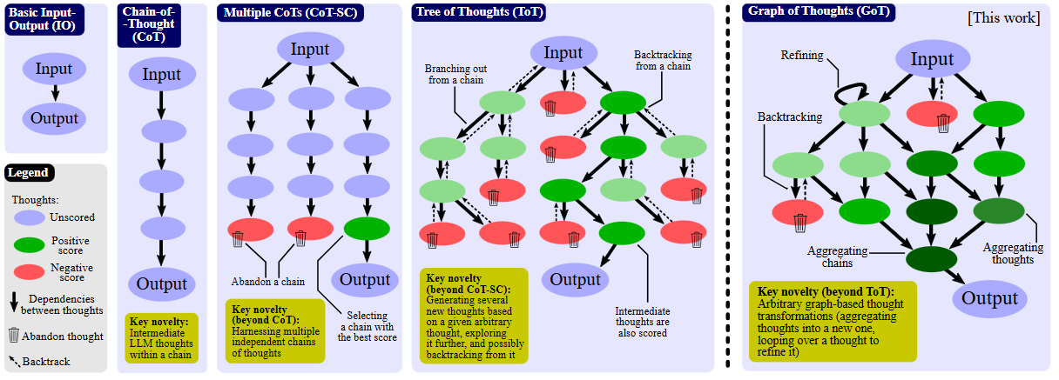
Traditional Prompting Techniques: An Overview

Slide 10
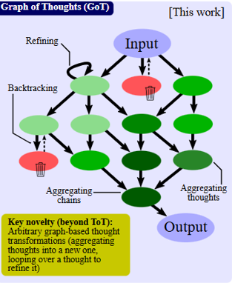
Graph of Thoughts (GOT) : New Paradigm of Prompting
Graph of Thoughts (GoT) is an innovative framework that enhances prompting capabilities in large language models (LLMs) like GPT-3 by modeling reasoning as a graph. In this structure, vertices represent LLM “thoughts” or intermediate solutions, while edges denote their dependencies.
This graph-based approach enables the aggregation and refinement of ideas through feedback loops, allowing for more nuanced control over reasoning chains compared to traditional methods.
Key Advantages of GoT:
Breaks complex tasks into manageable subtasks
Solves these subtasks independently
Combines incremental solutions effectively
GoT improves accuracy and decreases inference costs, outperforming prior methods in tasks such as sorting, set operations, keyword counting, and document merging.
For example, it achieves a 62% increase in sorting accuracy over tree-of-thoughts and cuts costs by over 31%.
Overall, GoT aligns LLM reasoning with human thought processes, advancing prompting paradigms through this interconnected approach.
Notes:
Graph of Thoughts (GoT) is a new framework enhancing prompting capabilities in large language models (LLMs) like GPT-3.
In GoT, the reasoning process is modeled as a graph, with vertices representing LLM “thoughts” or intermediate solutions and edges indicating dependencies between them.
This allows for innovative combinations and transformations of thoughts, such as aggregating the best ideas and refining them through feedback loops, providing finer-grained control over reasoning chains compared to previous methods.
Key advantages of GoT include:
Breaking down complex tasks into smaller subtasks
Independently solving these subtasks
Incrementally combining solutions
This approach improves accuracy and reduces inference costs, outperforming prior prompting schemes on tasks like sorting, set operations, keyword counting, and document merging.
For instance, GoT improves sorting accuracy by 62% over tree-of-thoughts and reduces costs by over 31%.
Overall, modeling LLM reasoning as a graph aligns it more closely with human thought processes, advancing prompting paradigms through this networked approach.
Reference link: https://sbagency.medium.com/llm-based-agents-reasoning-cot-tot-got-c46d792f776a

Slide 11
Enhancing LLMs efficiency for task or Domain specific use cases

Slide 12
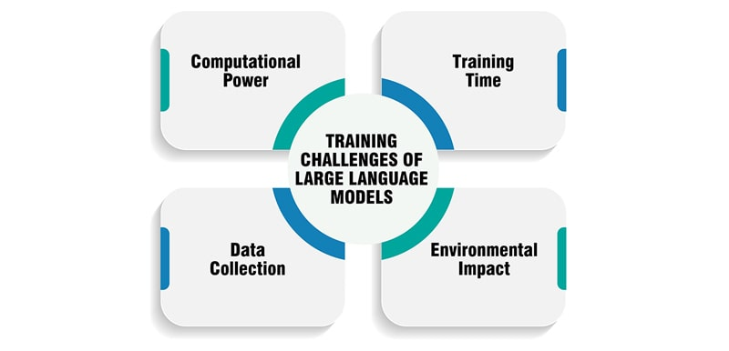
Challenges in Training Large Language Models from scratch
Alternative:
Due to these challenges, we will discuss a few alternative strategies that are more efficient to adapt LLMs for our specific Use case:
Parameter Efficient Fine Tuning: Adapter based and tuning techniques
Distillation Techniques

Slide 13
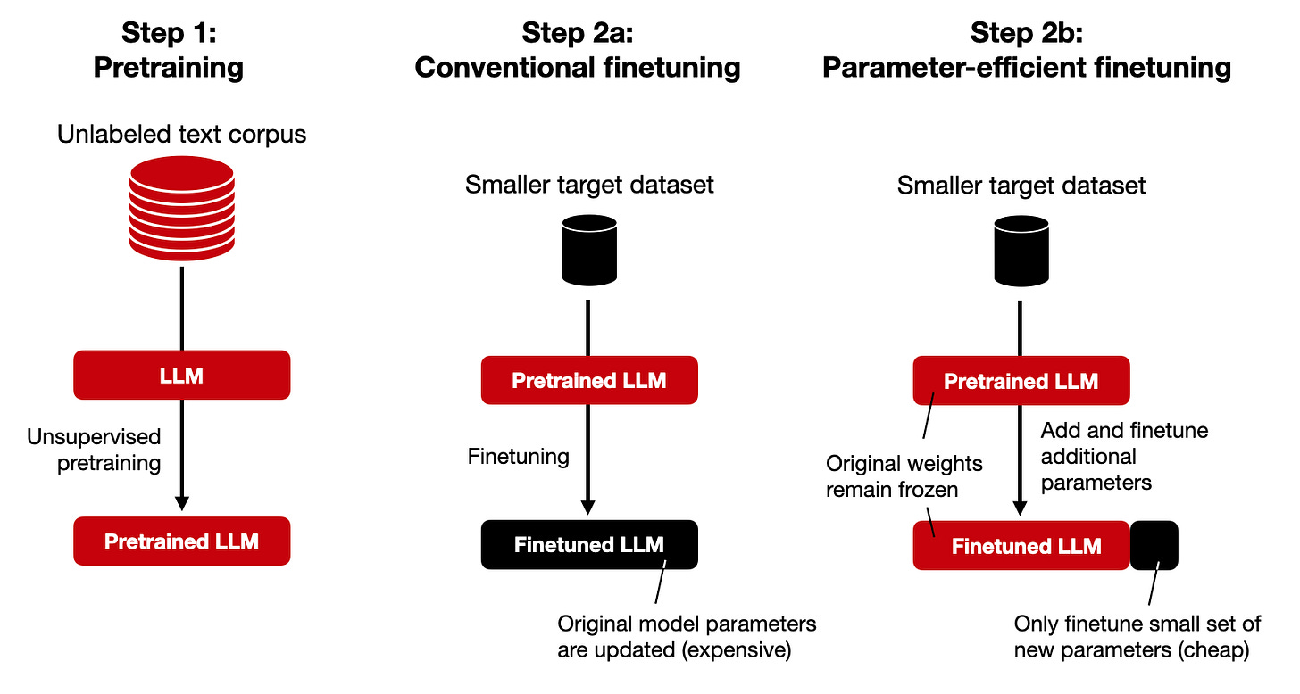
Parameter Efficient fine tuning (PEFT)

Slide 14
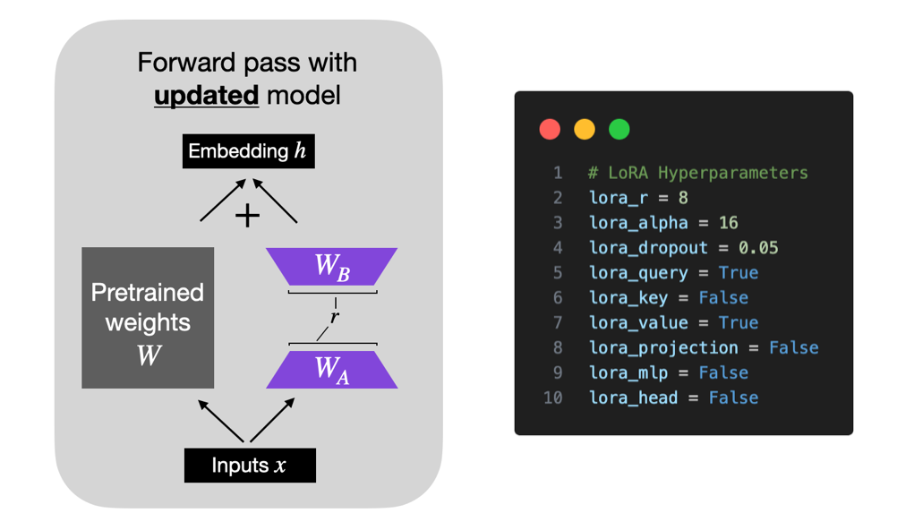
LoRA & QLoRA
LoRA (Low-Rank Adaptation)
Mechanism: Fine-tunes LLMs by injecting trainable low-rank matrices into attention layers while freezing the original model weights.
Advantages:
Reduces memory usage by avoiding full parameter updates.
Maintains performance close to full fine-tuning.
Faster and cheaper due to fewer trainable parameters.
Use Cases: Tailoring LLMs for specific domains (finance, healthcare), enhancing multilingual capabilities, and building personalized AI models.
QLoRA (Quantized LoRA)
Mechanism: Further reduces memory use by quantizing model weights to 4-bit precision while applying LoRA adapters.
Advantages:
Extreme memory efficiency allows fine-tuning large models (e.g., 65B parameters) on consumer GPUs.
Minimal performance trade-off ensures model quality.
Cost-effective compared to full fine-tuning.

Slide 15
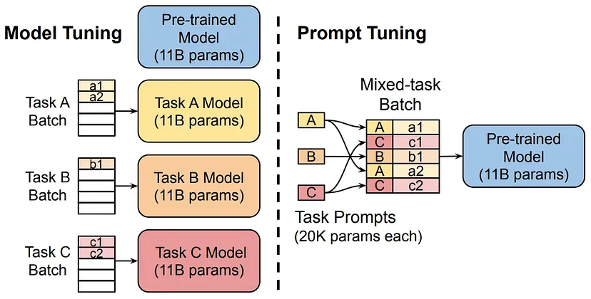
Prompt Tuning
Prompt Tuning is a parameter-efficient fine-tuning technique where small trainable embeddings (soft prompts) are added to the input of a frozen pre-trained model, optimizing performance for specific tasks without modifying model weights.
🔹 How It Works
Pre-trained model remains frozen → No need to fine-tune full model.
Trainable prompt embeddings are added to input text.
Only the prompt embeddings are optimized, guiding the model’s responses.
🔹 Advantages ✅ Efficient – Requires training only a small number of parameters. ✅ Memory-friendly – Works with large models without full fine- tuning. ✅ Task adaptability – Enables LLMs to specialize in new domains (e.g., legal, medical).
🔹 Real-World Example 📌 Improving ChatGPT for Legal Assistance
Instead of fine-tuning the full model, custom soft prompts train it to better interpret legal queries without retraining millions of parameters.
This Photo by Unknown Author is licensed under CC BY-NC-ND

Slide 16
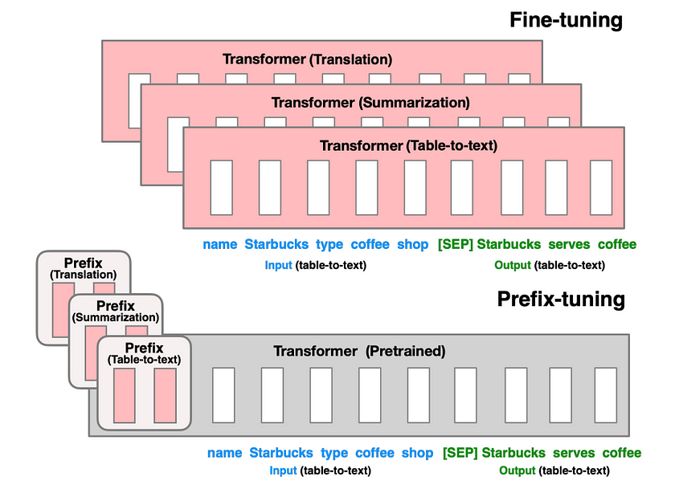
Prefix Tuning
Prefix Tuning is a parameter-efficient fine-tuning technique where a trainable prefix (continuous embeddings) is prepended to the model’s activations at every layer, guiding its responses without modifying model weights.
How It Works
Pre-trained model remains frozen → No need to update millions of parameters.
Learnable prefix embeddings are added to each layer's input.
Only the prefix embeddings are optimized, influencing how the model processes text.
🔹 Advantages ✅ More flexible than Prompt Tuning – Works across all layers, not just the input. ✅ Memory-efficient – Requires fewer trainable parameters than full fine-tuning. ✅ Better control over model behavior – Effective for specialized tasks (e.g., summarization, creative writing).
🔹 Real-World Example :
Customizing GPT-3 for Medical Q&A
Instead of fine-tuning the entire model, Prefix Tuning trains specialized prefix embeddings to guide responses toward accurate medical advice.
Fine-Tuning: Changes all parameters.
Prefix Tuning: Only optimizes small trainable embeddings added to each layer.

Slide 17
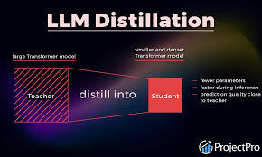
Converting LLMs to SLMs - Distillation

Slide 18
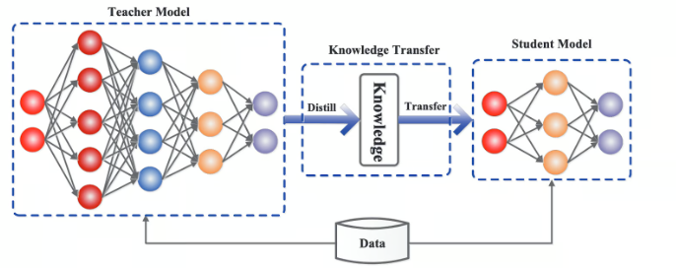
Knowledge Distillation
Distillation is a technique where a smaller "student" model learns from a larger "teacher" model, replicating its knowledge with fewer parameters.
How Model Distillation Works
Train a large teacher model on a dataset.
Transfer knowledge via soft labels and logits instead of raw labels.
Train a smaller student model to mimic the teacher’s outputs.
Advantages ✅ Reduces model size. ✅ Faster inference since smaller models process data more quickly. ✅ Lower computational cost.
Use Cases
Deploying efficient AI assistants on mobile devices.
Reducing latency in real-time applications.
Creating customized AI models with near-teacher accuracy.

Slide 19
Other Distillation Techniques
Data augmentation : generating additional training data using the teacher model. By creating a larger and more inclusive dataset, the student can be exposed to a broader range of scenarios and examples, improving its generalization performance.
Intermediate layer distillation : Instead of focusing solely on the final outputs, this method transfers knowledge from the intermediate layers of the teacher model to the student.
Multi-teacher distillation: By aggregating knowledge from various teachers, the student can achieve a more comprehensive understanding and improved robustness

Slide 20
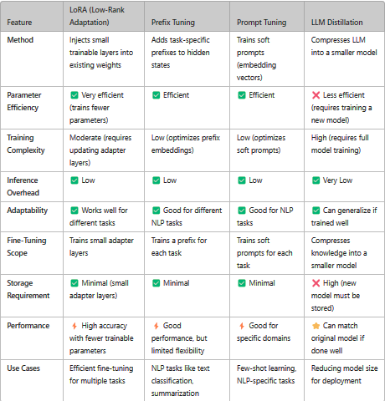
Comparison Between LORA, Prefix Tuning, Prompt Tuning, LLM distillation

Slide 21

Conclusion: Unlocking Language Potential with Large Language Models
In conclusion, our exploration of Large Language Models (LLMs) highlights their transformative potential in understanding and generating human language. We examined three key components essential to maximizing LLM effectiveness: tokenization strategies, prompting techniques, and fine-tuning methodologies.
Tokenization serves as the foundation of LLM functionality, enabling precise processing of diverse language inputs.
Effective prompting strategies empower users to guide LLMs toward relevant responses, enhancing the interaction between humans and machines.
Finally, fine-tuning allows us to customize models for specific applications, optimizing their performance.
As we move forward, the continuous evolution of LLMs and these supporting strategies opens up new possibilities in language understanding and generation. By leveraging insights from today’s discussion, we can drive innovation in communication and knowledge sharing.
Thank you for joining me in unlocking the immense potential of language through Large Language Models!

Slide 22


Slide 23
Comparison: Prefix Tuning vs. Prompt Tuning vs. LoRA
Feature | Prefix Tuning 🟠 | Prompt Tuning 🔵 | LoRA 🟢
Definition | Adds trainable prefix embeddings to model activations at each layer | Adds trainable prompt embeddings to input tokens | Injects trainable low-rank matrices into model layers
Model Weights | Frozen (only prefix embeddings updated) | Frozen (only prompt embeddings updated) | Frozen (only LoRA layers trained)
Optimization Scope | Entire model (multiple layers) | Input layer only | Targeted model layers (e.g., attention layers)
Efficiency | Moderate memory usage | Most memory-efficient | Requires more memory than tuning methods but less than full fine-tuning
Performance | Higher flexibility (influences all layers) | Lower control (affects only input interpretation) | Better balance of efficiency & performance
Best for | Text generation, summarization, question answering | Few-shot learning, task-specific adjustments | Domain adaptation, personalization
Real-World Example | Customizing GPT-3 for scientific writing | Adapting LLaMA for customer service queries | Fine-tuning LLaMA-7B for legal AI
Computational Cost | Lower than full fine-tuning, but higher than Prompt Tuning | Lowest (only affects input layer) | Higher than Prefix & Prompt Tuning, but optimized for efficiency
Key Takeaways
✅ Use Prompt Tuning if you need the lightest memory footprint for quick task adaptation. ✅ Use Prefix Tuning for deeper model control while keeping efficiency. ✅ Use LoRA when fine-tuning performance is critical but you still need efficiency.

Slide 24
Deep Seek R1 –Case study

Slide 25
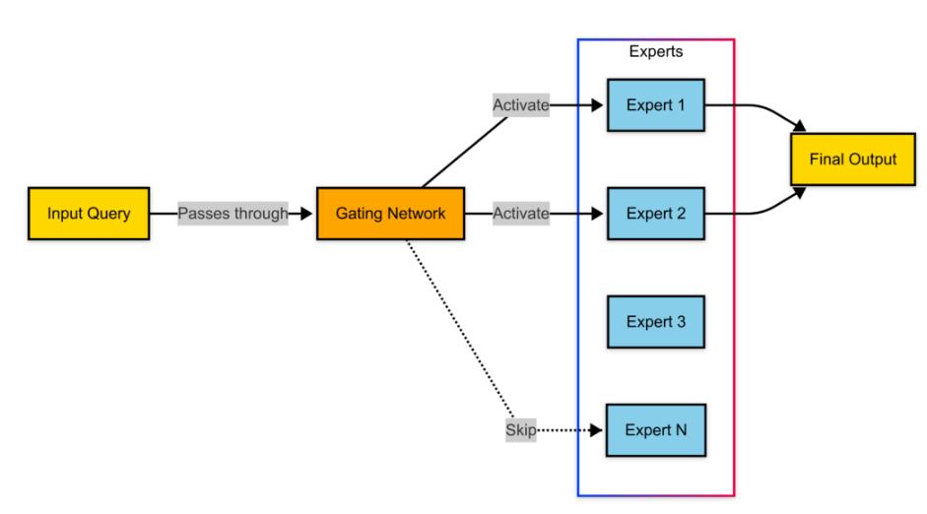
Concept Introduction: Mixture of Experts (MoE) Architecture
Expert Selection and Routing Algorithm
During inference, DeepSeek-R1 uses a learned routing mechanism that efficiently selects relevant experts based on input context.
Step 1: The input is passed through a lightweight gating network that assigns a probability distribution over all experts.
Step 2: The model selects a subset of the highest-ranked experts (typically 2-4 per query).
Step 3: Selected experts process the query in parallel, producing intermediate representations.
Step 4: Outputs from experts are aggregated through a weighted sum mechanism, forming the final response.
Notes:
https://research.google/blog/mixture-of-experts-with-expert-choice-routing/

Slide 26
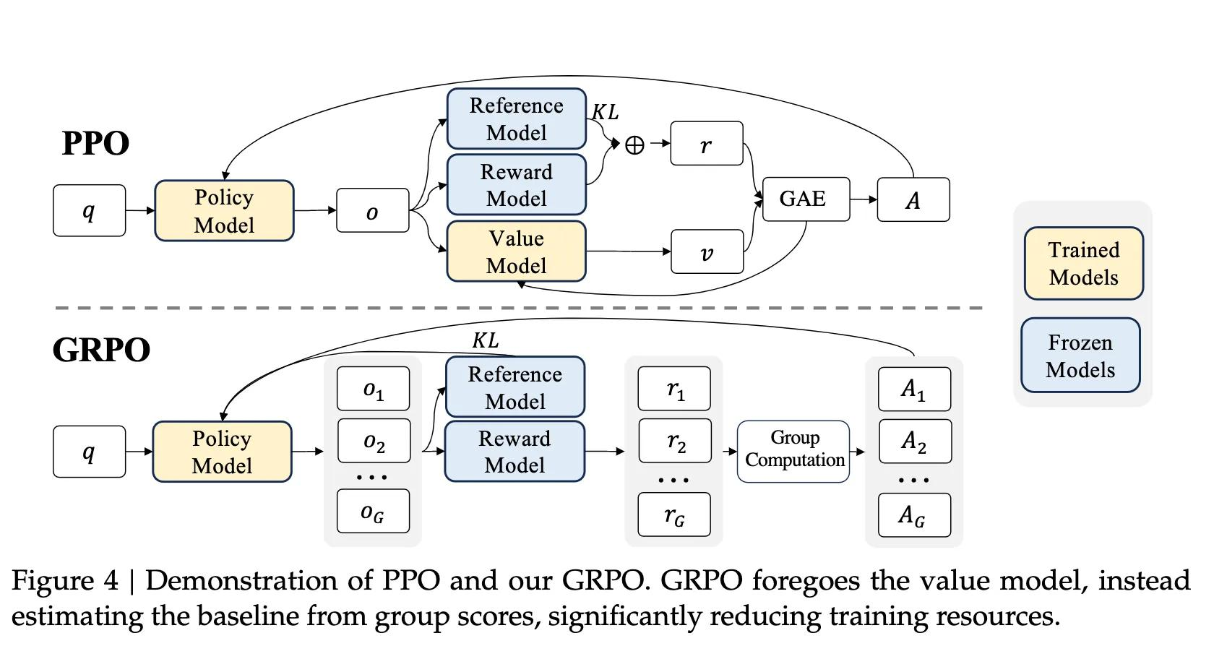
Concept Introduction: Reinforcement Learning through GRPO
Group Relative Policy Optimization: GRPO is an RL algorithm designed to address PPO's limitations.
It eliminates the need for a value function model by using group-based advantage estimation and integrates KL divergence directly into the loss function for improved stability.
Key Innovations in GRPO include:
No Value Function Model: Unlike PPO, GRPO eliminates the need for a separate value function model. This simplifies training and reduces memory usage, making it more efficient.
Group-Based Advantage Calculation: GRPO leverages a group of outputs for each input, calculating the baseline reward as the average score of the group. This group-based approach aligns better with reward model training, especially for reasoning tasks.
Direct KL Divergence Optimization: Instead of incorporating KL divergence into the reward signal (as in PPO), GRPO integrates it directly into the loss function, providing finer control during optimization.

Slide 27
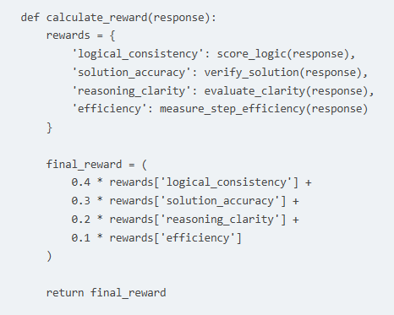
Concept: Reward Calculation Algorithm

Slide 28
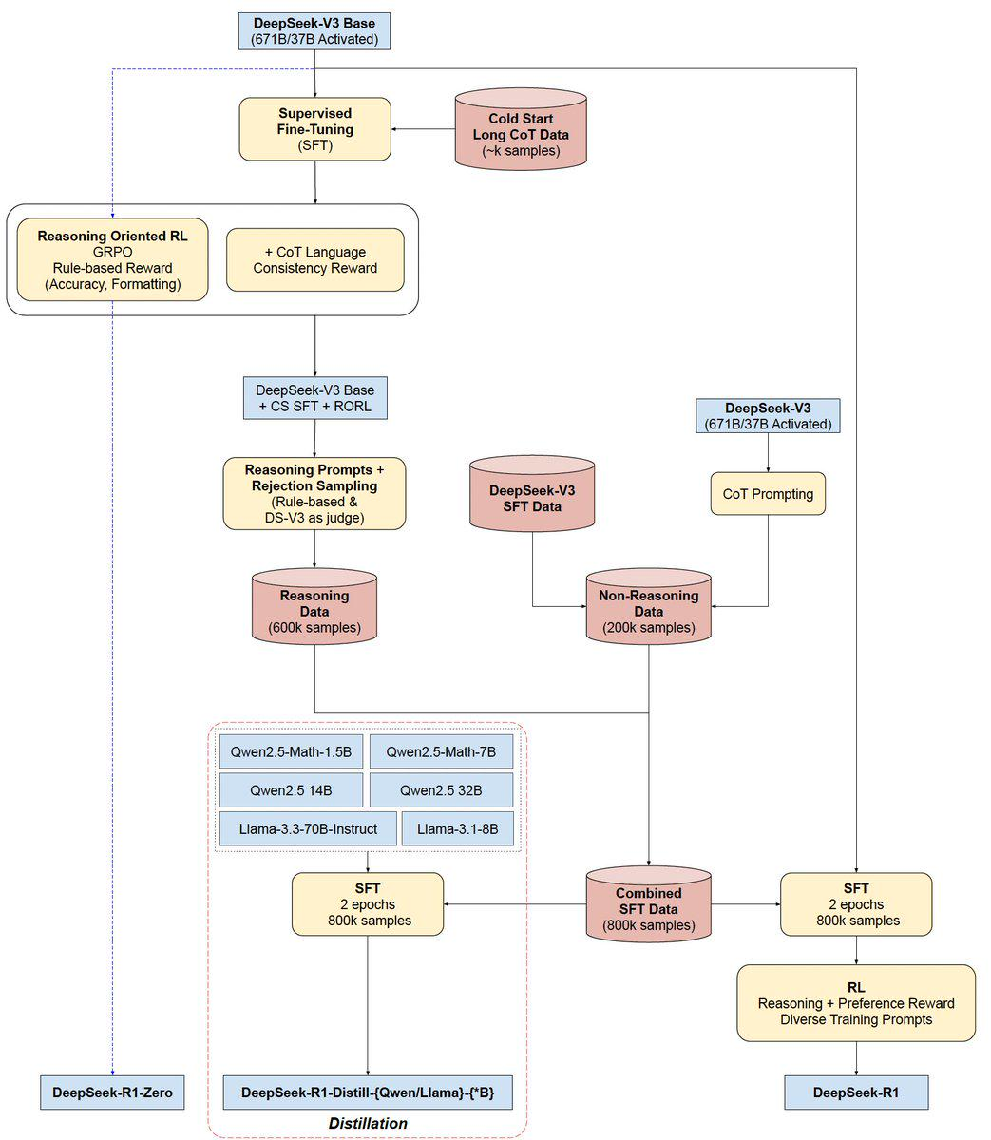
Deep Seek R1 Architecture - Deep Dive

Slide 29
Conclusion
Key Innovations
Efficient Parameter Utilization
By activating only, a subset of experts per query, DeepSeek-R1 achieves computational savings while maintaining performance
Pure Reinforcement Learning Training
The model's training relies entirely on reinforcement learning, eliminating the need for supervised fine-tuning.
Implications
Cost-Effective AI Development
DeepSeek-R1 demonstrates that advanced AI capabilities can be achieved with reduced computational resources, making high-performance AI more accessible.
Open-Source Advancement
As an open-source model, DeepSeek-R1 provides the research community with valuable insights into efficient AI training and inference methodologies.
Notes:
https://blog.adyog.com/2025/02/01/how-deepseek-r1-was-built-architecture-and-training-explained/?utm_source=chatgpt.com
https://www.vellum.ai/blog/the-training-of-deepseek-r1-and-ways-to-use-it?utm_source=chatgpt.com
https://aipapersacademy.com/deepseek-r1/?utm_source=chatgpt.com
https://github.com/deepseek-ai/DeepSeek-R1?utm_source=chatgpt.com
https://www.geeky-gadgets.com/the-story-of-deepseek-r1/?utm_source=chatgpt.com

Slide 30
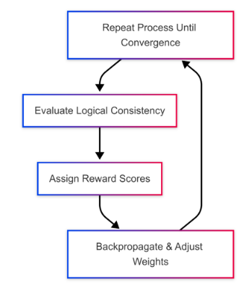
Reinforcement Learning Implementation
DeepSeek-R1 utilizes reward modeling and reinforcement learning to fine-tune its reasoning abilities.
Step 1: Generate multiple outputs for a given query.
Step 2: Evaluate outputs based on logical consistency and correctness.
Step 3: Assign reward values to different response structures.
Step 4: Train the model using reinforcement learning to favor high-reward outputs.

Slide 31
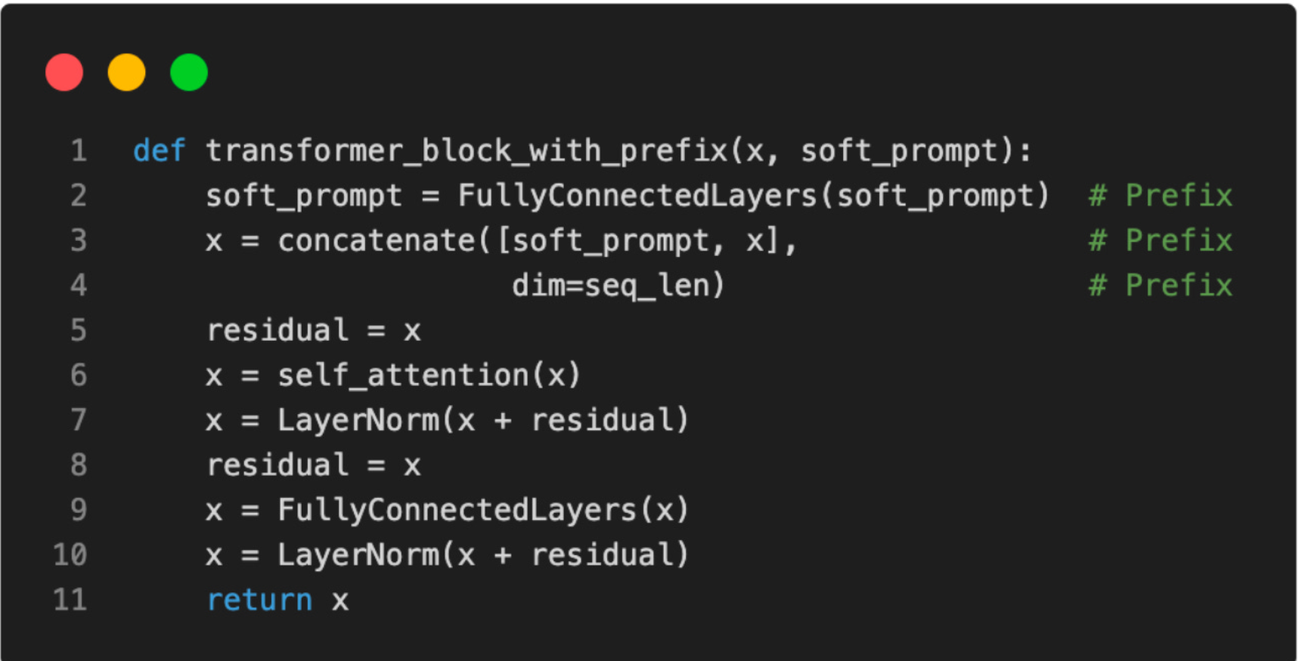
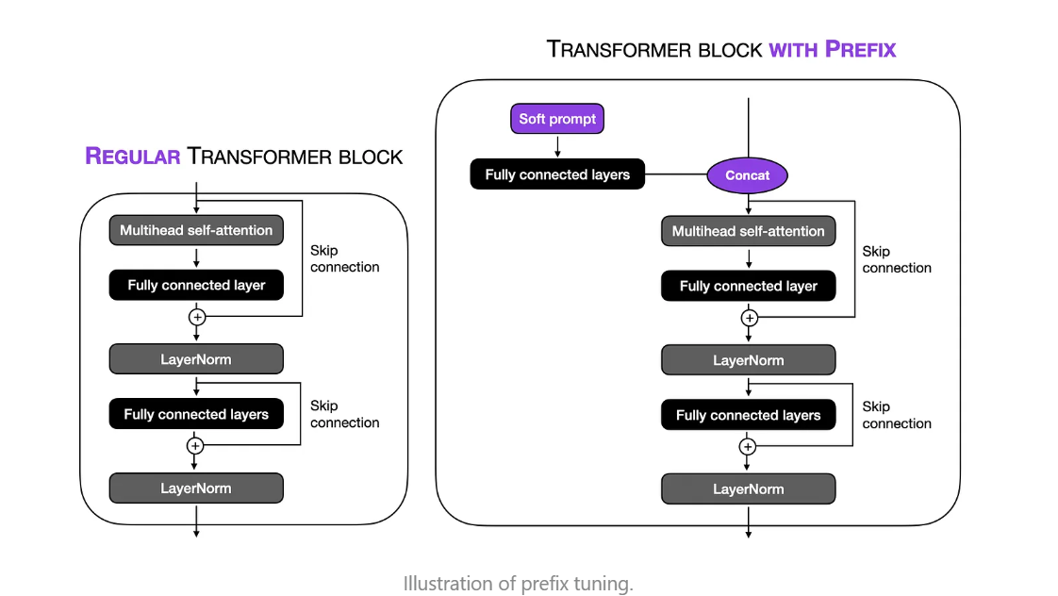
Prefix Tuning-Implementation

Slide 32
QLoRA – Quantized LoRA
QLoRA is an advanced LoRA technique that reduces memory usage even further by using 4-bit quantization while applying LoRA adapters.
🔹 How QLoRA Works
Quantize model weights to 4-bit precision for lower memory consumption.
Apply LoRA adapters to specific layers, similar to LoRA.
Train only the adapters, keeping the quantized base model fixed.
🔹 Advantages ✅ Extreme memory efficiency – Enables fine-tuning large models (e.g., 65B parameters) on consumer GPUs. ✅ Minimal performance trade-off – Retains model quality despite quantization. ✅ Cost-effective – Reduces training costs compared to full fine-tuning.
🔹 Use Cases
Fine-tuning huge models on limited hardware (e.g., single-GPU setups).
Deploying efficient AI models on edge devices.
Diagram info: Visual Diagram:
✅ Side-by-side comparison of Teacher vs. Student models
Teacher model (Large LLM) → Produces logits/soft labels.
Student model (Smaller LLM) → Mimics teacher’s predictions but is much smaller.
Real-World Example:
📌 BERT → DistilBERT (60% smaller, 97% performance)
Google distilled BERT into DistilBERT, which is twice as fast with almost the same accuracy, making it ideal for real-time applications.

Slide 33
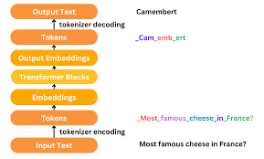
Notes:
https://www.tensorops.ai/post/what-is-mixture-of-experts-llm#viewer-3pq61216

Slide 34
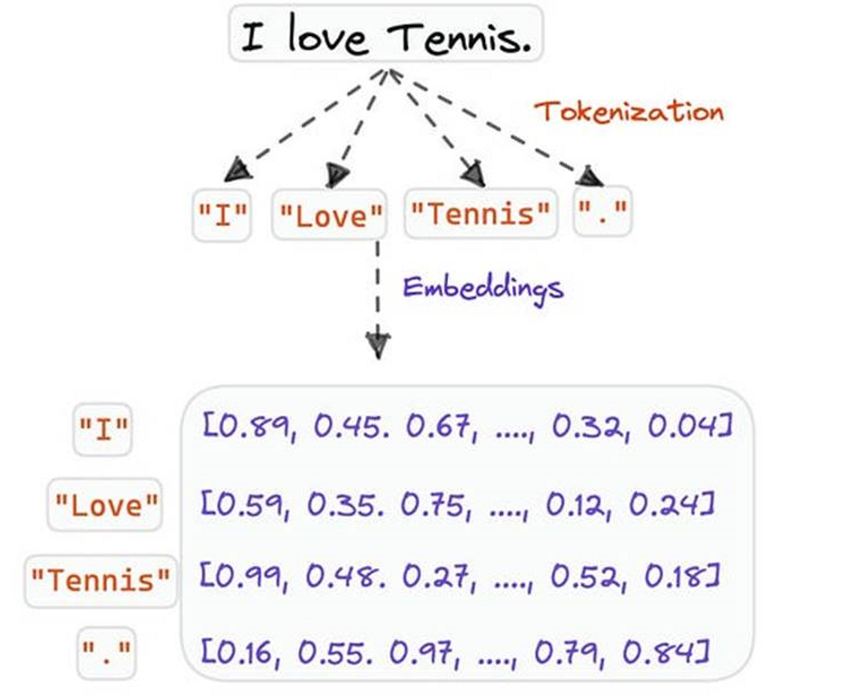
Why we need Tokenization ? How does it work ?
Impact on Model Performance : An effective tokenization strategy reduces computational load by streamlining the model’s input, optimizing processing speed, and lowering memory usage.
Impact on Capturing Linguistics Patterns: Tokens serve as building blocks in Large Language Models.
How LLM reads sentences ? : The LLM doesn’t read the sentence as we do. Instead, it reads a sequence of tokens, like ["Token", "ization", "helps", "model", "s", "understand", "language"].
Steps:
Parsing and Embedding: Each token is converted into a numerical vector through a process called embedding. These vectors help the model understand relationships between words.
Context and Prediction: When generating language, LLMs use these token embeddings to predict the most likely next token in a sequence, helping them form coherent and meaningful sentences.
This way, the model processes language as a sequence of tokens, making it more efficient and capable of understanding and generating language that reflects human communication.

Slide 35
What is tokenization?
Unstructured text data suck as articles , social media posts, lacks a predefined structure that machines can interpret. Tokenization bridges the gap by breaking down the text into smaller units called tokens.
These tokens can be words, characters or even sub words, depending on the tokenization strategy.
Type of tokenization chosen for a particular task at hand lays the foundation further analysis and processing.

Slide 36
Top Level Architecture
DeepSeek-R1 is a text-generation AI model designed for complex reasoning and logical inference.
Based on a Mixture of Experts (MoE) architecture, which allows it to dynamically allocate computational resources to different specialized components.
Total Parameters: 671B, but only 37B active per inference step.
Expert Networks: Multiple specialized networks trained on different domains of knowledge.
Routing Mechanism: A gating network decides which experts to activate per query, optimizing efficiency.
Training Methodology is through Reinforcement Learning (RL) Focus
Chain-of-Thought (CoT) Reasoning
During inference, the model utilizes CoT reasoning, generating intermediate steps to solve complex problems. This method enhances the model's ability to handle tasks requiring logical progression and detailed analysis.
Parallelization Strategy: (Distributed training techniques)
Model Parallelism: Large layers are split across multiple GPUs to handle extensive computation.
Data Parallelism: Training data is distributed across GPUs, allowing synchronized updates to parameters.
Pipeline Parallelism: Different model components are processed simultaneously, reducing latency.

Slide 37
Graph of Thought

Slide 38


Slide 39
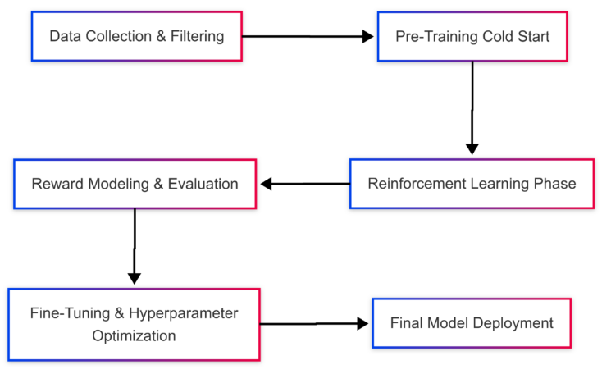
Training Methodology
DeepSeek-R1’s training methodology includes reinforcement learning (RL) for reasoning.
This strategy allows the model to improve its logical consistency and adaptability without requiring large-scale human annotations.
Data Preparation
The model’s training corpus includes:
Filtered Web Data: Pre-cleaned, high-quality textual data.
Domain-Specific Knowledge: Mathematical, scientific, and reasoning datasets.
Self-Generated Feedback Data: AI-generated responses evaluated and curated for self-improvement.
Pre-training Strategy : Initial training follows a two-phase approach:
Cold Start Phase (2 weeks):
Basic language comprehension training.
Minimal supervised fine-tuning (~1% of standard approaches).
Reinforcement Learning Phase (8 weeks):
Self-improvement through trial and error.
Adaptation of reasoning strategies.
Notes:
Initial training follows a two-phase approach:
Cold Start Phase (2 weeks):
Basic language comprehension training.
Minimal supervised fine-tuning (~1% of standard approaches).
Reinforcement Learning Phase (8 weeks):
Self-improvement through trial and error.
Adaptation of reasoning strategies.

Slide 40
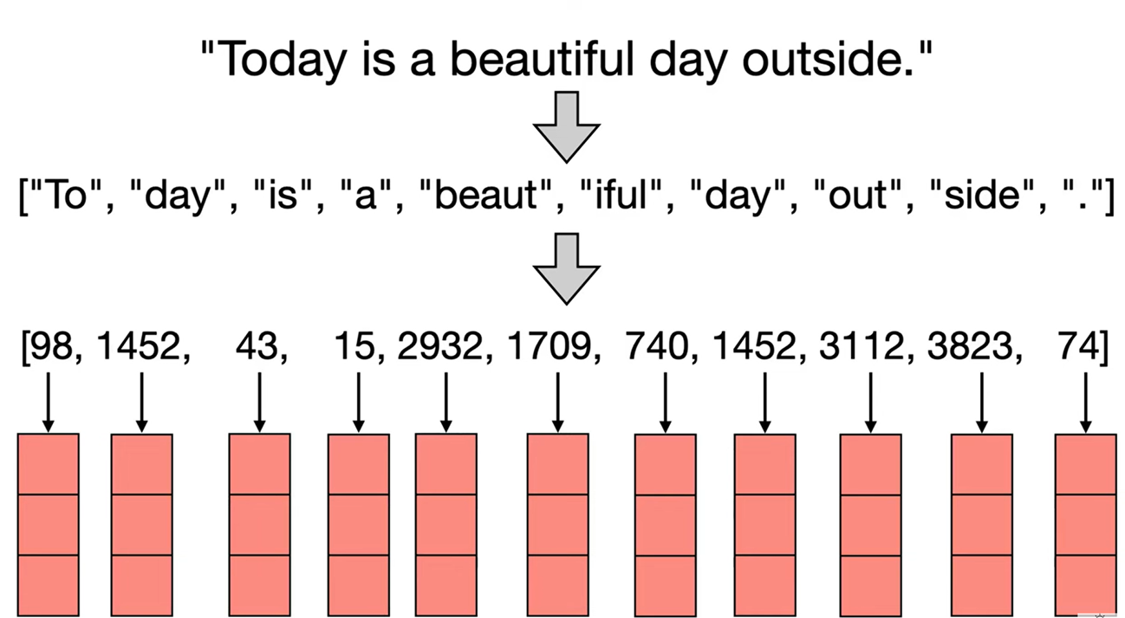
Why we need Tokenization ?
Tokenization is not merely about splitting text; it sets the stage for how well an LLM can capture nuances in language, context, and even rare vocabulary.
Impact on Model Performance : The choice of tokenization strategy directly impacts how efficiently a model performs, the level of detail it understands, and the overall quality of its output.
An effective tokenization strategy reduces computational load by streamlining the model’s input, optimizing processing speed, and lowering memory usage.
It also improves accuracy by capturing more context and meaning, making responses more relevant, accurate, and reliable.

Slide 41
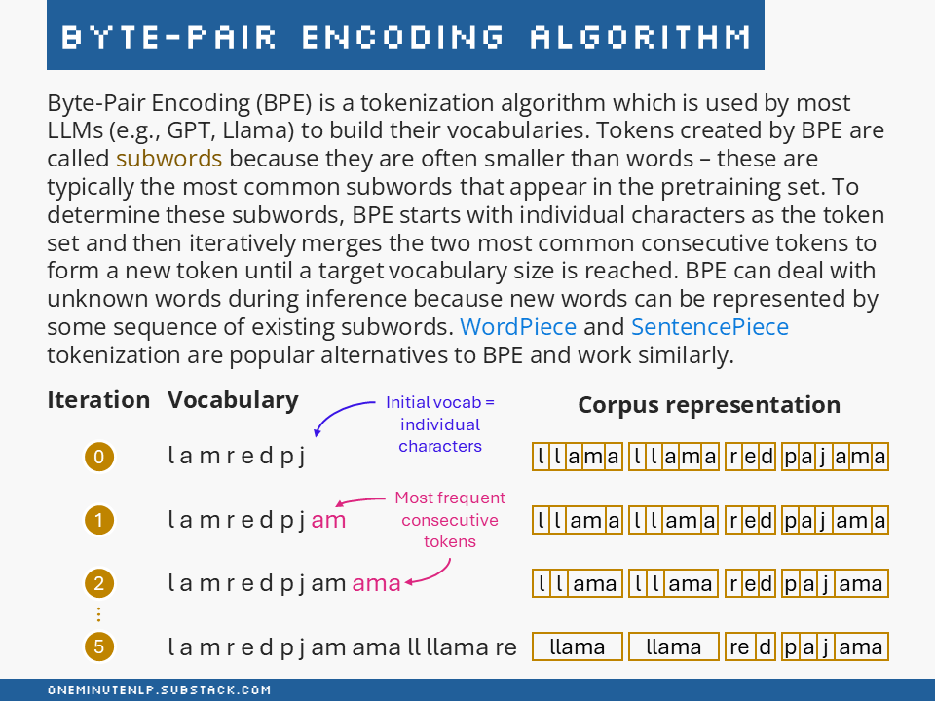

Slide 42
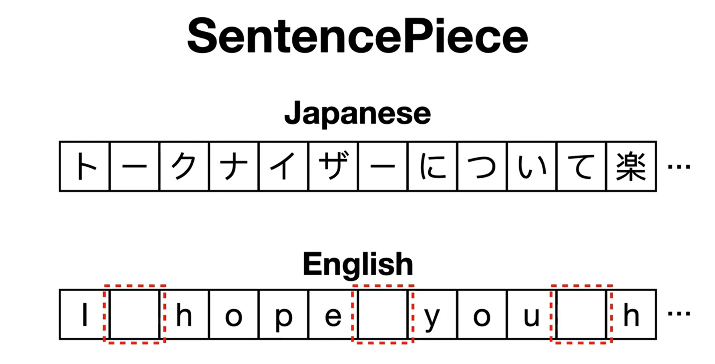

Slide 43
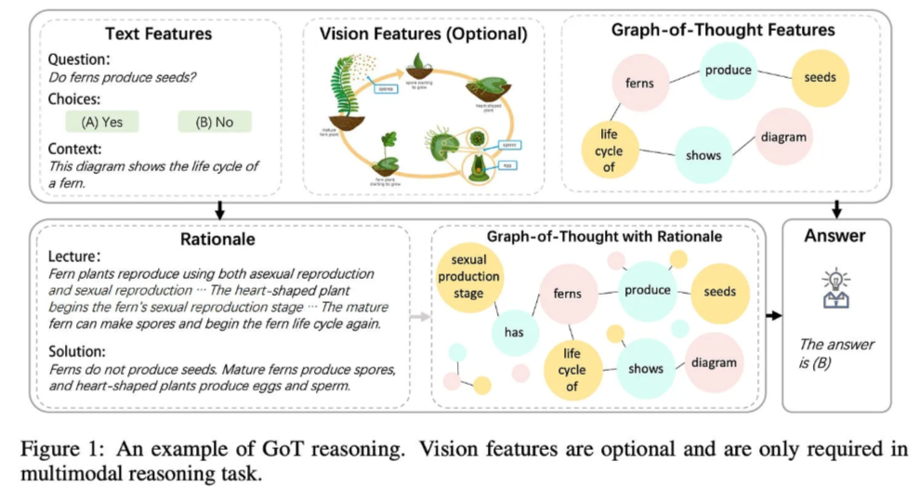
Notes:
https://medium.com/towards-data-science/graph-based-prompting-and-reasoning-with-language-models-d6acbcd6b3d8

Slide 44
